Slide 1
Global PSP Project for Indian Embassies and Consulates
Quick Guide – Review Cancellation List screen

Slide 2
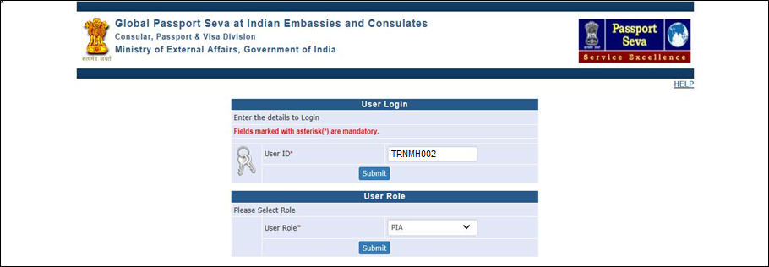
Login Using User ID, Password, and Grid Values
Visit Global PSP Office Portal (https://embassy.passportindia.gov.in)
Enter User ID
Press Submit button
Choose User Role as ‘PIA’ to access the Review Cancellation List screen
Press Submit button displayed below the User Role

Slide 3
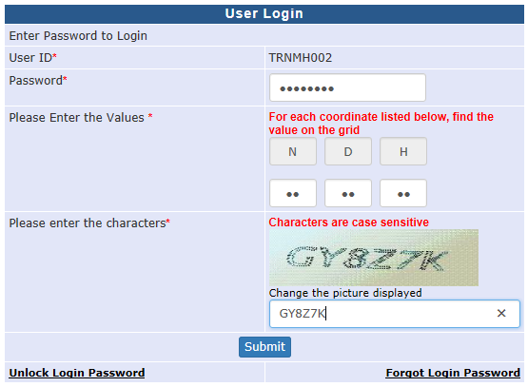
Login Using User ID, Password, and Grid Values (continued..)
Enter Password
Check your User Grid and enter the values for the three alphabets displayed on the screen
Enter the characters displayed in the CAPTCHA image
Press Submit button

Slide 4
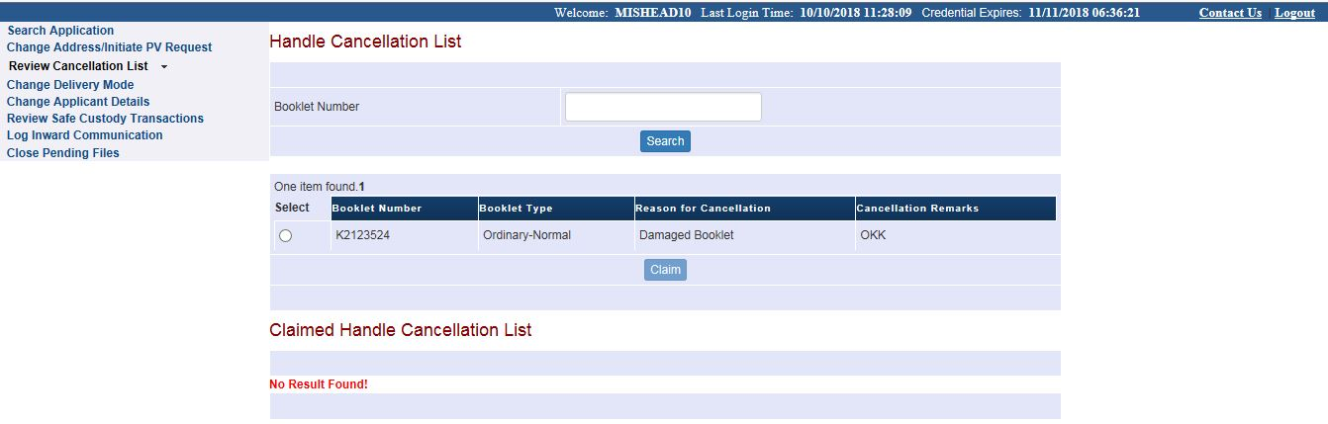
Review Cancellation List
Select the (Passport) Booklet Number from the work list. User may also enter the Booklet Number and press the Search Button to fetch the booklet (if exists in the worklist)
Press Claim button to open the details and take further action on the case
Notes:
4

Slide 5
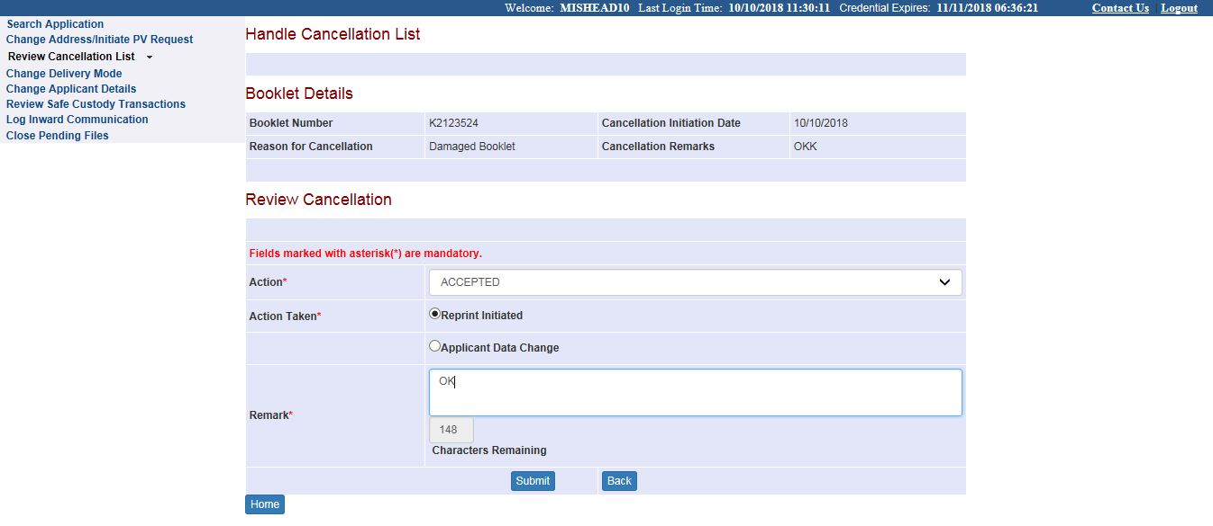
Review Cancellation List (continued..) → Accepted case
Select Action as Accepted from the drop down menu to accept the Cancellation of Passport Booklet Number in the system
Select Action Taken as Reprint initiated if no change in passport printable data is required before reprinting of passport.
Select Action Taken as Applicant Data Change (such cases would be visible in “Change Applicant Details” screen of PIA users)
Enter appropriate Remarks and press submit button
Notes:
5

Slide 6
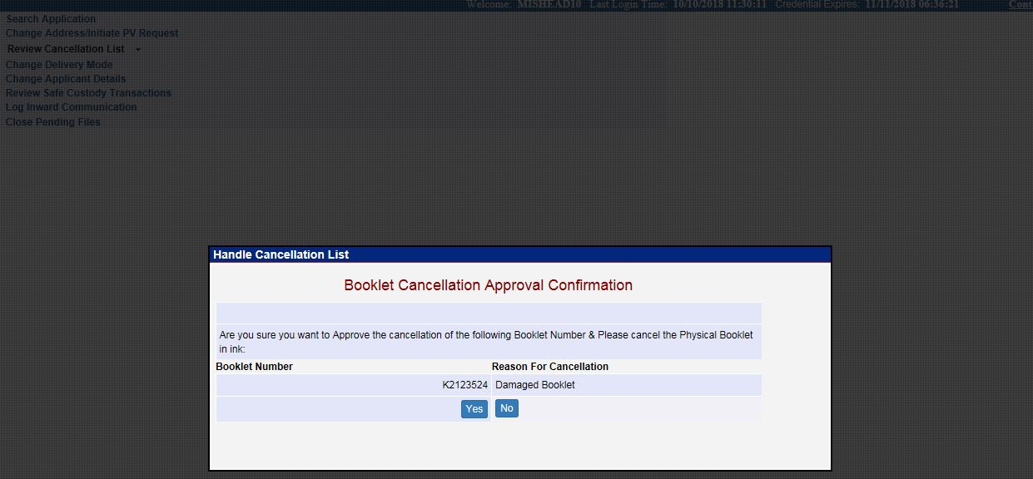
Review Cancellation List → Accepted case (continued..)
Press the Yes button for confirming submission of the decision. (The application workflow reaches the PIA users’ worklist (“Change Applicant Details” screen) for ‘Applicant Data Change’ cases; or to Printer Operators’ worklist for ‘Reprint Initiated’ cases )
Press the No button for revisiting the case
Notes:
6

Slide 7
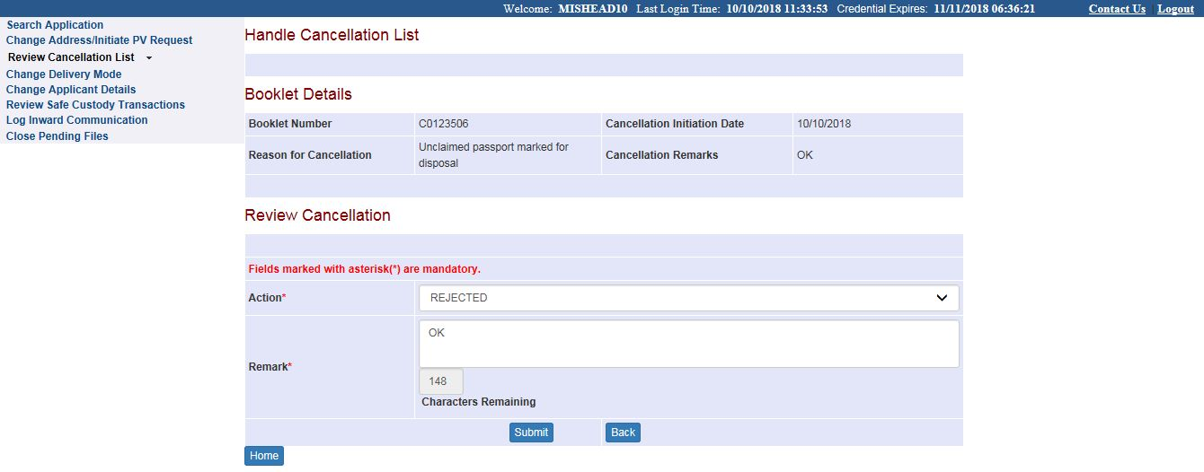
Review Cancellation List (continued..) → Rejected case
Select Action as Rejected from the drop down menu to reject cancellation (i.e. accept as Valid) of the selected Booklet Number
Enter appropriate Remarks and press submit button
Notes:
7

Slide 8
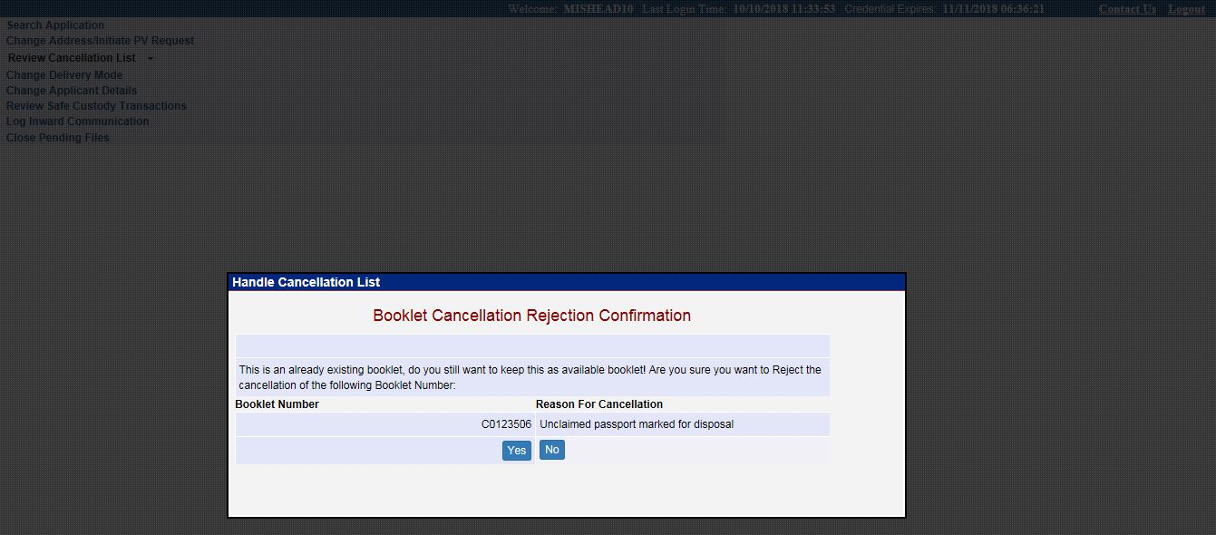
Review Cancellation List → Rejected case (continued..)
Press the Yes button for confirming submission of the decision. (The application workflow would reach the Dispatch Assistant or Counter Delivery Assistant users’ worklist as per the applicable Passport Issuance mode; or would reach the Safe Custody assistant’s worklist (“Store in Safe Custody” screen) if any stop on passport processing is imposed)
Press the No button for revisiting the case
Notes:
8

Slide 9
In case of additional information or clarification, please contact Global PSP Support Team at
Email : global.psp@tcs.com
Phone : +91-0120-672-9595/96
Mobile : +91-730-351-9595
Thank You

